Slide 1
Java 4 WEB
Lesson 17 – Spring Boot

Slide 2
Lesson goals
Spring Boot introduction

Slide 3
Spring Boot Features
Create stand-alone Spring applications
Embed Tomcat, Jetty or Undertow directly (no need to deploy WAR files)
Provide opinionated 'starter' POMs to simplify your Maven configuration
Automatically configure Spring whenever possible
Provide production-ready features such as metrics, health checks and externalized configuration
Absolutely no code generation and no requirement for XML configuration
Notes:
Let the model manage the data, the view display the data and the controller mediate updating the data and redrawing the display.

Slide 4
Spring Boot. Quick Start: Gradle
buildscript { ext { springBootVersion = '2.1.3.RELEASE' } repositories { mavenCentral() } dependencies { classpath("org.springframework.boot:spring-boot-gradle-plugin:${springBootVersion}") } } apply plugin: 'org.springframework.boot' apply plugin: 'io.spring.dependency-management' repositories { mavenCentral() } dependencies { compile('org.springframework.boot:spring-boot-starter-web') compile('org.springframework.boot:spring-boot-starter-thymeleaf') }
Notes:
Let the model manage the data, the view display the data and the controller mediate updating the data and redrawing the display.

Slide 5
Spring Boot. Quick Start: Java
@SpringBootApplication public class Application extends WebMvcConfigurationSupport { public static void main(String[] args) { SpringApplication.run(Application.class, args); } }
Notes:
Let the model manage the data, the view display the data and the controller mediate updating the data and redrawing the display.

Slide 6
Spring Boot. application.properties
Spring Boot supports without any configuring:
application.properties
application.yml
This files should be placed in resources
Each file supports it own format
To add your own property file(s) you should use @PropertySource annotation
Notes:
Let the model manage the data, the view display the data and the controller mediate updating the data and redrawing the display.

Slide 7
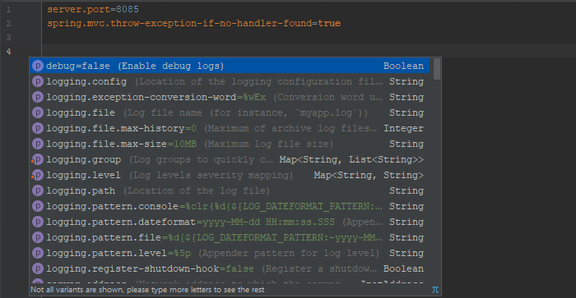
Spring Boot. application.properties
Notes:
Let the model manage the data, the view display the data and the controller mediate updating the data and redrawing the display.

Slide 8
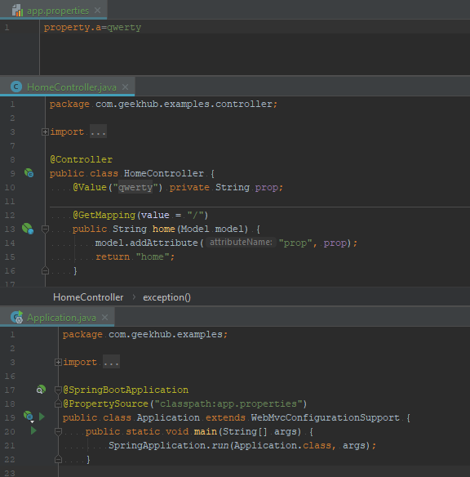
Spring Boot. Custom properties source
Notes:
Let the model manage the data, the view display the data and the controller mediate updating the data and redrawing the display.

Slide 9
Spring Boot. Annotations
@SpringBootApplication
@EnableAutoConfiguration
@SpringBootConfiguration
@ComponentScan
@Configuration
@Import
@EnableJpaAuditing
@EnableTransactionManagement
@EnableJpaRepositories
@EnableScheduling
@EnableAspectJAutoProxy
Notes:
Let the model manage the data, the view display the data and the controller mediate updating the data and redrawing the display.

Slide 10
Spring Boot. REST API example
@RestController public class HomeRestController { @GetMapping("rest") public List<String> rest() { return List.of("str1", "str2", "str3", "qwerty"); } @GetMapping("user-from-form") @ResponseStatus(HttpStatus.ACCEPTED) public UserDto modelAttribute(@ModelAttribute UserDto user) { return user; } @PostMapping("user-from-body") public UserDto requestBody(@RequestBody UserDto user) { return user; } @GetMapping("put-to-session") public void toSession(@RequestParam String data, HttpSession session) { session.setAttribute("data", data); } @GetMapping("get-from-session") public String fromSession(@SessionAttribute String data) { return data; } }
Notes:
Let the model manage the data, the view display the data and the controller mediate updating the data and redrawing the display.

Slide 11
Spring Boot. Advanced Configuration
@SpringBootApplication @PropertySource("classpath:app.properties") public class Application extends WebMvcConfigurationSupport { public static void main(String[] args) { SpringApplication.run(Application.class, args); } @Override public void addInterceptors(InterceptorRegistry registry) { registry.addInterceptor(new ControllerLogInterceptor()); } @Override protected void addArgumentResolvers(List<HandlerMethodArgumentResolver> argumentResolvers) { super.addArgumentResolvers(argumentResolvers); } @Override protected void configureHandlerExceptionResolvers(List<HandlerExceptionResolver> exceptionResolvers) { super.configureHandlerExceptionResolvers(exceptionResolvers); } @Override public RequestMappingHandlerMapping requestMappingHandlerMapping() { return super.requestMappingHandlerMapping(); } @Autowired public void dispatcherServlet(DispatcherServlet dispatcherServlet) { dispatcherServlet.setThrowExceptionIfNoHandlerFound(true); } }
Notes:
Let the model manage the data, the view display the data and the controller mediate updating the data and redrawing the display.

Slide 12
Spring Boot Test. Standalone Setup
public class HomeRestControllerTest { private MockMvc mockMvc; private Gson gson; @BeforeMethod public void setUp() { gson = new Gson(); mockMvc = MockMvcBuilders.standaloneSetup(new HomeRestController()) .setMessageConverters(new GsonHttpMessageConverter()) .build(); } @Test public void listAsJsonReturned_when_callRestEndpoint() throws Exception { final String expected = gson.toJson(List.of("str1", "str2", "str3", "qwerty")); mockMvc.perform(get("/rest")) .andExpect(status().isOk()) .andExpect(content().json(expected, true)); } @Test public void acceptedResponseStatus_when_sendUserViaForm() throws Exception { mockMvc.perform(get("/user-from-form")) .andExpect(status().isAccepted()); } /*...*/ }
Notes:
Let the model manage the data, the view display the data and the controller mediate updating the data and redrawing the display.

Slide 13
Spring Boot Test
@SpringBootTest @AutoConfigureMockMvc public class HomeRestControllerBootTest extends AbstractTestNGSpringContextTests { private Gson gson; @Autowired private MockMvc mockMvc; @BeforeMethod public void setUp() { gson = new Gson().newBuilder().serializeNulls().create(); } @Test public void listAsJsonReturned_when_callRestEndpoint() throws Exception { final String expected = gson.toJson(List.of("str1", "str2", "str3", "qwerty")); mockMvc.perform(get("/rest")) .andExpect(status().isOk()) .andExpect(content().json(expected, true)); } @Test public void acceptedResponseStatus_when_sendUserViaForm() throws Exception { mockMvc.perform(get("/user-from-form")) .andExpect(status().isAccepted()); } /*...*/ }
Notes:
Let the model manage the data, the view display the data and the controller mediate updating the data and redrawing the display.

Slide 14
Literature
Spring Boot Docs
Tutorial: Thymeleaf + Spring
Spring Boot Test

Slide 15
Homework 1
Use Spring Boot to create WEB application from Lecture 16
Add custom interceptor using Java config
Interceptor should print:
Information about request start (including date, time, link, all request parameters, method that was used (GET, POST, PUT, etc))
Information about request end (including date, time, link, time was spend for request processing, method that was used (GET, POST, PUT, etc))
Information about exception if happened
Add custom ControllerAdvice with handling some custom exceptions (prepare endpoints that can throw this exception)
Add custom JSON message converter using Java config
Add few endpoints that return different dtos (data transfer objects), list of dtos, etc to show that converter works
Add external properties source (ex.: custom-prop-file.yml) to get additional properties (use yaml property file(s))
Implement and use LoggerService for logging all exception messages and other data into console or file (use properties to specify type of output)

